Slide 1
Managing Information Technology Resources ITWS 4310
Data, Big Data, and Design
October 22, 2018

Slide 2
Managing IT Resources Class Outline: Mon, Oct 22, 2018
MITR Term Project
Schedule Meetings with Client and Invite Faculty to Meetings
Work on Design and Development
Draft of Entire Term Project Final Report on Nov 19 by 9 PM
Current Events
Data Management
Data Design

Slide 3
Managing IT Resources: ITWS 4310 Term Project Report Outline
Section 1: Executive Summary
Section 2: Introduction
Section 3: Client Organization and Description
Section 4: Project Team
Section 5: Problem Statement
Section 6: IS/IT Solution
Section 7: Methodology
Section 8: IS/IT Requirements
Section 9: IS/IT Design and Development
Section 10: Cost-Benefit Analysis with (Risk Mgmt)
Section 11: Project Plan/Schedule/Resources
Section 12: Post-Turnover Plan
Section 13: Results and Client Feedback
Section 14: Conclusions
All Sections of Final Report in Draft due by Nov 19 (Mon before Thanksgiving) at 9 PM

Slide 4
Managing IT Resources: ITWS 4310 Term Project Report Outline
Section 9: IS/IT Design and Development
Use-Case Summary (part of narrative) and Use-Case Diagram
Work Flow Diagram (logic that connect back-end with front-end)
Back-end Design including Data Work Flow and Database Design
Front-end Design including Mock-ups, Wireframes, Screen Shots
Working System including link to working system or prototype
Access to Code in Code Repository
Narrative of All Design and Development
Testing Plan(s)
Section 12: Post-Turnover Plan
Installation
Training
Documentation
Section 13: Results and Client Feedback
Results showing that the System meets the “Requirements” or not
Client Feedback
Section 14: Conclusions

Slide 5
Technology Current Events: “Amazon just revisited these cities as HQ2 decision imminent”, Fox Business, Oct 19, 2018. https://www.foxbusiness.com/features/amazon-just-revisited-these-cities-as-hq2-decision-imminent
The wait is almost over. Amazon CEO Jeff Bezos said he plans to announce the finalist for the company’s second headquarters by the end of the year and according to the Wall Street Journal report, it could be one of five cities.
According to the report, Amazon executives have visited New York City, Newark, N.J., and Chicago over the past couple months. Additionally, the company has been following up with other locations, including Miami and the Washington, D.C. area, all five of which are among the 20 finalists for its $5 billion second-headquarters project. However, other cities, like Raleigh, N.C., haven’t heard from the e-commerce giant in months, notes the Journal.
While an Amazon spokesperson did not immediately respond to FOX Business’ request for comment on the report, there has been a lot of buzz surrounding Chicago as a top contender.
In August, the Chicago Tribune reported that representatives for the company made a second visit to the Windy City to check out a new 62-acre development site called The 78.
However, last month, news that Amazon joined the D.C. Chamber of Commerce fueled speculation that the company could be narrowing in on that area.
So much so, that last week, the New York Times reported that many analysts believe that Northern Virginia checks the most boxes when it comes the ideal spot. It noted that the area is already home to Amazon’s cloud computing division and to top it off, Bezos, already owns a massive mansion in the area and the biggest newspaper—The Washington Post.

Slide 6
Technology Current Events: “Apple Calls on Bloomberg to Retract Story That Claimed China Snuck Spy Chips on Apple Servers”, Fortune, Oct 19, 2018. http://fortune.com/2018/10/19/apple-demands-bloomberg-retract-chinese-hardware-hacking-story/
Apple CEO Tim Cook said Bloomberg Businessweek should retract an investigative article it published Oct. 4 that claimed servers bought by Apple, Amazon, and over two dozen other unidentified companies contained spy circuitry installed by China.
In an interview with Buzzfeed News, Cook said: “There is no truth in their story about Apple. They need to do that right thing and retract it.” Cook, who said he was involved in discussions with Bloomberg reporters from the beginning, stated that the news organization never presented Apple with specific details, and believes the story relied on “vague secondhand accounts.” Apple previously denied it had contacted or been contacted by the FBI or other government agencies, also claimed in the story.
Buzzfeed noted that Apple has never previously asked publicly for an article’s retraction, even when the company has denied its accuracy. A search of newspaper archives appears to confirm that.
While no party involved has argued that Bloomberg fabricated information, Cook’s call for a retraction comes closest to alleging that the news outlet failed to verify accounts provided by its sources.
Bloomberg continues to stand by its reporting, according to a statement provided to Fortune by a company spokesperson.

Slide 7
Technology Current Events: “Walmart's strategy to solve the Amazon puzzle is working”, CNN Business, Oct 20, 2018. https://www.cnn.com/2018/10/19/business/walmart-stores-grocery-pickup-amazon/index.html
Walmart is in the biggest fight of its 68-year history.
To stave off Amazon and remain the world's biggest retailer, Walmart is stepping up its grocery game and buying trendy digital brands. The company is redesigning its stores and building up its online assets.
"We're changing. We're adapting. We continue to transform," chief executive Doug McMillon said at Walmart's annual investor gathering on Tuesday.
Walmart (WMT) is marching forward with a two-track strategy designed for different customer segments: It's offering cheaper and more convenient ways to buy groceries for its low-and-middle income base, while acquiring high-end brands— including Bonobos and Modcloth— todraw wealthier shoppers long wary of Walmart's image.
The plan is working: Grocery sales growth is at a nine-year high. Walmart's online sales are expected to grow 40% this year, and the company said Tuesday that digital growth will expand by 35% in 2019.
"They are one of the few incumbents that has effectively landed some counter punches on Amazon," said Jason Goldberg, head of the commerce practice at digital agency SapientRazorfish.

Slide 8
Data Management
Creation of logical collections
Physical data handling
Interoperability support
Security support
Data ownership
Metadata collection, management and access.
Persistence
Knowledge and information discovery
Data dissemination and publication
Notes:
Derived from
Data Management Systems for Scientific Applications
IFIP Conference Proceedings; Vol. 188
Proceedings of the IFIP TC2/WG2.5 Working Conference on the Architecture of Scientific Software
Pages: 273 - 284
Year of Publication: 2000
ISBN:0-7923-7339-1
Reagan Moore
Kluwer, B.V. Deventer, The Netherlands, The Netherlands

Slide 9

Physical Data Handling
Where and who does the data come from?
How is it transferred into a physical form?
Backup, archiving, and caching...
Data formats
Naming conventions

Slide 10
Interoperability Support
Bit/byte and platform/ wire neutral encodings
Programming or application interface access
Data structure and vocabulary (metadata) conventions and standards
Definitions of interoperability?
Smallest number of things to agree on so that you do not need to agree on anything else

Slide 11
Security
What mechanisms exist for securing data?
Who performs this task?
Change and versioning (yes, the data may change), who does this, how?
Who has access?
How are access methods controlled, audited?
Who and what – authentication and authorization?
Encryption and data integrity

Slide 12

Data Ownership
Rights and policies – definition and enforcement
Limitations on access and use
Requirements for acknowledgement and use
Who and how is quality defined and ensured?
Who may ownership migrate too?
How to address replication?
How to address revised/ derivative products?
Notes:
Science commons

Slide 13

Metadata
Know what conventions, standards, best practices exist
Use them – can be hard, use tools
Understand costs of incomplete and inconsistent metadata
Understand the line between metadata and data and when it is blurred
Know where and how to manage metadata and where to store it (and where not to)
Metadata CAN be added later in many cases

Slide 14
Persistence
Where will you put your data so that someone else (e.g. one of your class members) can access it?
What happens after the class, the semester, after you graduate?
What other factors are there to consider?

Slide 15
Discovery
If you choose (see ownership and security), how does someone find your data?
How would you provide discovery of collections, versus files, versus ‘bits’?
How to enable the narrowest/ broadest discovery?

Slide 16

Dissemination
Who should do this?
How and what needs to be put in place?
How to advertise?
How to inform about updates?
How to track use, significance?

Slide 17
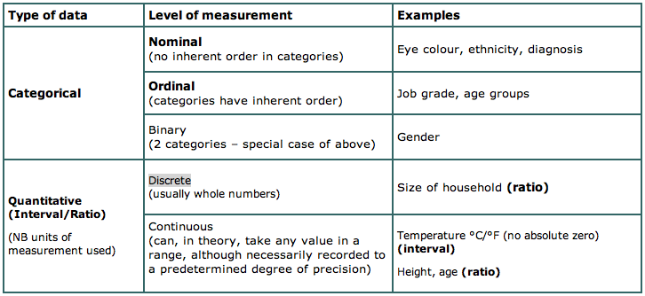
Types of data
Notes:
http://hsc.uwe.ac.uk/dataanalysis/quantIssuesTypes.asp
--ratio has a true zero

Slide 18
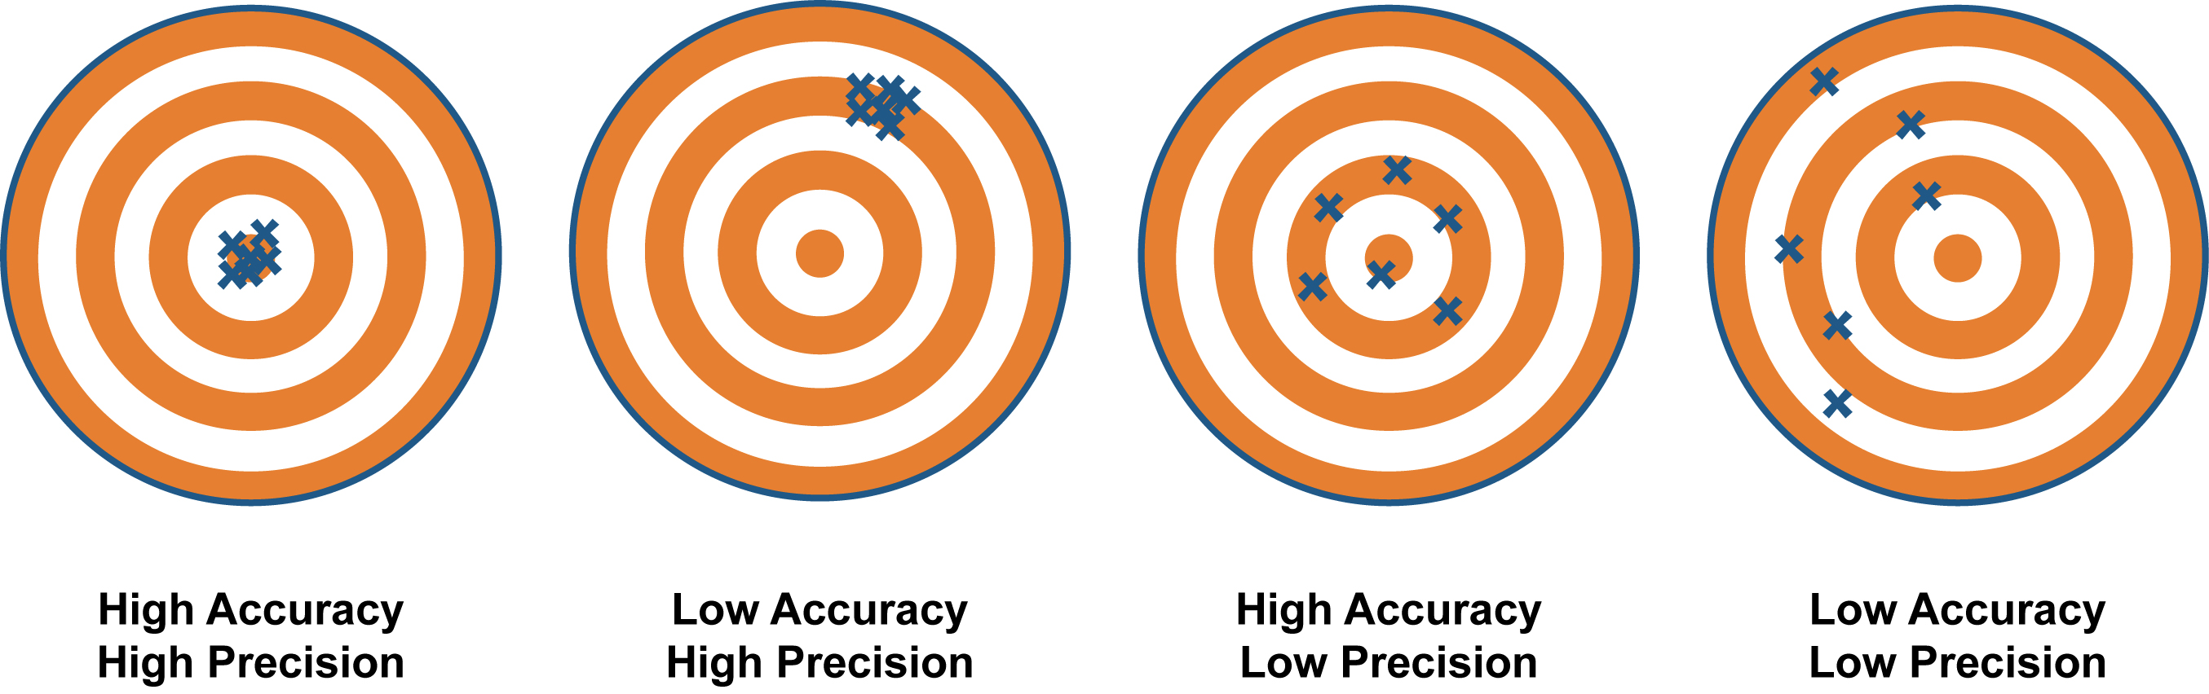
Accurate vs. Precise
http://climatica.org.uk/climate-science-information/uncertainty

Slide 19
‘Signal to noise’
Understanding accuracy and precision
Accuracy
Precision
Affects choices of analysis
Affects interpretations (g-i-g-o)
Leads to data quality and assurance specification
Signal and noise are context dependent
Notes:
accuracy - true
Precision - clustered in an area
signal to noise - temperature example

Slide 20
Data and Design In-Class Exercise
Develop a Use Case Diagram for your Term Project
Use any Work Flow Charting Tool
If you don’t have one, try LucidChart, free trial at www.lucidchart.com
Develop a Work Flow Diagram for your Term Project
Use any Work Flow Charting Tool
Develop a Data Flow Diagram for your Term Project
Use any Work Flow Charting Tool

Slide 21
Use Case
Is a collection of possible sequences of interactions between the system under discussion and its Users (or Actors), relating to a particular goal.
The collection of Use Cases should define all system behavior relevant to the actors to assure them that their goals will be carried out properly.
Any system behavior that is irrelevant to the actors should not be included in the use cases.

Slide 22
Use Case
is a prose description of a system's behavior when interacting with the outside world.
is a technique for capturing functional requirements of business systems and, potentially, of an IT system to support the business system.

Slide 23
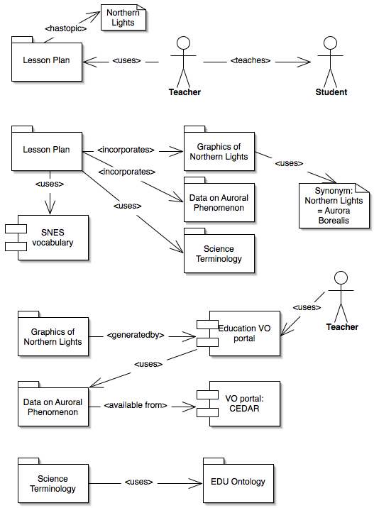
Schematic

Slide 24
What is a workflow?
General definition: series of tasks performed to produce a final outcome
E.g. following a recipe to bake a pie
Scientific workflow – “data analysis pipeline”
Automate tedious jobs that scientists traditionally performed by hand for each dataset
Process large volumes of data faster than scientists could do by hand
Notes:
Adapted from Slides by Bill Howe UW 2006

Slide 25
Background: Business Workflows
Example: planning a trip
Need to perform a series of tasks: book a flight, reserve a hotel room, arrange for a rental car, etc.
Each task may depend on outcome of previous task
Days you reserve the hotel depend on days of the flight
If hotel has shuttle service, may not need to rent a car
E.g. tripit.com
Notes:
Adapted from Slides by Bill Howe UW 2006

Slide 26
Normal (process) flows/Work Flows
A basis step of (usually) distinct steps that result when the use case is triggered (commences)
Steps are often separated by actor intervention or represent modular parts of the flow (can encapsulate activities)
Can have loops
Should end with the final goal achieved

Slide 27
Process flow
Each element in the process flow usually denotes a distinct stage in what will need to be implemented
Often, actors mediate the process flow
Consider the activity diagram (and often a state diagram) as a means to turn the written process flow into a visual one that your experts can review
Make sure the artifacts and services have an entry in the resources section

Slide 28
Data Flow Diagram
A data flow diagram (DFD) maps out the flow of information for any process or system
Illustrates how data is processed by a system in terms of inputs and outputs.
As its name indicates its focus is on the flow of information, where data comes from, where it goes and how it gets stored.
Notes:
https://www.smartdraw.com/data-flow-diagram/

Slide 29
Data Flow Diagram
Notes:
https://www.smartdraw.com/data-flow-diagram/

Slide 30
Data and Design In-Class Exercise
Develop a Use Case Diagram for your Term Project
Use any Work Flow Charting Tool
If you don’t have one, try LucidChart, free trial at www.lucidchart.com
Develop a Work Flow Diagram for your Term Project
Use any Work Flow Charting Tool
Develop a Data Flow Diagram for your Term Project
Use any Work Flow Charting Tool
Due as part of project report!

